Slide 1


The pillars of rights: fundamental and their core attributes
Domenico Mangieri - 1883920
Master’s degree in Data Science
Big Data for Official Statistics
Winter semester 2024/25

Slide 2
Outline
Goals
Data definition
Data pre-processing
Exploratory data analysis
Comparative analysis
Model based analysis
Time series predictions
Conclusion
Outline
17/12/2024
Slide <number>

Slide 3
Goals
Before diving into the analysis, it’s crucial to have clear the starting questions and objectives:
Correlation and Influence: How do Civil Liberties Index, Social Rights and Equality Index and Access to Justice Index correlate with each other and with Fundamental rights index?
Find some relationships between Fundamental rights index and the three sub-attributes.
Comparative Analysis: How do these indices differ across countries or region?
Compare the indicators across countries and over time to identify patterns and relationships.
Temporal Trends: How have these indices changed over time in a specific country or region?
Plot and analyze the trends of each indicator over time for some country and regions.
Predictions and Forecasting: Can we predict future values of these indices based on current trends and past data?
Models to predict future values and trends for the indices.
Goals
17/12/2024
Slide <number>

Slide 4

Data Definition
Where data came from?
International Institute for Democracy and Electoral Assistance (IDEA). The International IDEA is an intergovernmental organization that supports democracy worldwide.
On which data are we focused?
International IDEA launched the Global State of Democracy (GSoD) Initiative in 2016. This Initiative provides evidence-based, balanced analysis and data on the state and quality of democracy for 173 countries across the world. It aims to contribute to the public debate on democracy and inform policy interventions to strengthen democracy.
Which data will we use?
There are four indices that we will use: Fundamental Rights Index, Access to justice Index, Civil liberties Index, Social rights and equality Index.
Fundamental Rights Index (IDEA)
Fundamental Rights captures the degree to which civil liberties are respected, and whether people have access to basic resources that enable their active participation in the political process. This index is composed of three sub-attributes: access to justice, civil liberties, and social rights and equality. The three indices were aggregated into the Fundamental Rights index using Bivariate Factor Analysis(BFA).
Data Definition
17/12/2024
Slide <number>

Slide 5
Data Definition
Access to justice Index (IDEA)
The access to justice sub-attribute denotes the extent to which the legal system is fair (i.e., citizens are not subject to arbitrary arrest or detention and have the right to be under the jurisdiction of, and to seek redress from, competent, independent and impartial tribunals without undue delay). Five indicators (i.e., access to justice for men, access to justice for women, judicial corruption decision, judicial accountability and fair trial) were aggregated into the access to justice sub-attribute using BFA.
Civil liberties Index (IDEA)
The civil liberties sub-attribute denotes the extent to which civil rights and liberties are respected. The five civil liberties sub-components are freedom of expression, freedom of association and assembly, freedom of religion, freedom of movement, and personal integrity and security. The five sub-components were aggregated into the civil liberties index using BFA.
Social rights and equality Index (IDEA)
The social rights and equality sub-attribute denotes the extent to which basic welfare (i.e. social security, health care and education) and political and social equality between social groups and genders are realized. The three social rights and equality sub-components are social group equality, basic welfare and gender equality, each of which reflects core concepts in the human rights literature. The three sub-components were aggregated into this sub-attribute using BFA.
Data Definition
17/12/2024
Slide <number>

Slide 6
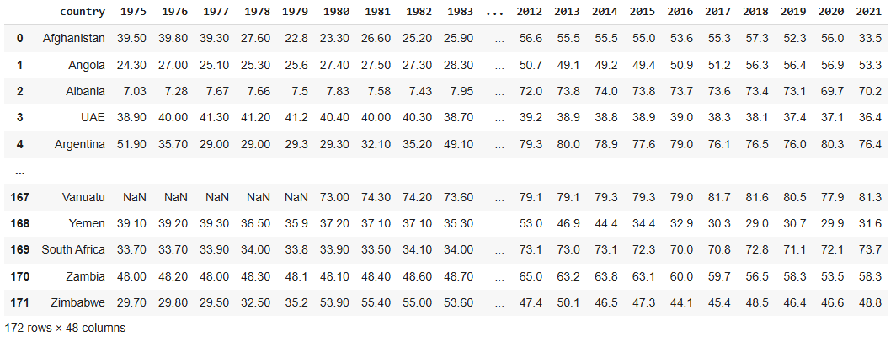
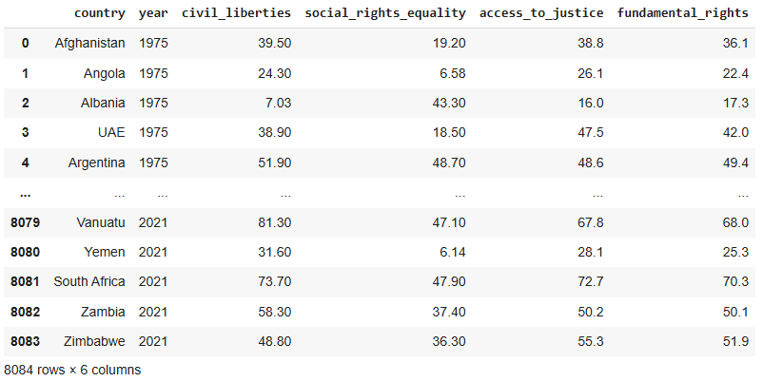
Data Preprocessing
Countries: 172
Years: 47
From 4 .csv files (one for each index) to a single merged dataset with country, year, and the four indices.
Data Preprocessing
17/12/2024
Slide <number>

Slide 7
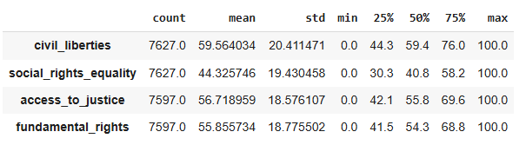
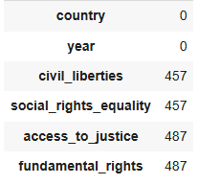
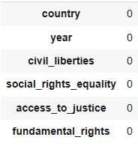
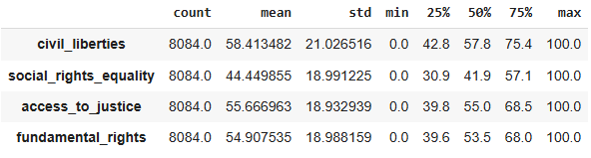
Missing Values
Manual imputation using values from linked countries based on historical development.
Difference after imputation: +- 1 in mean, std and % distribution.
Data Preprocessing
17/12/2024
Slide <number>

Slide 8
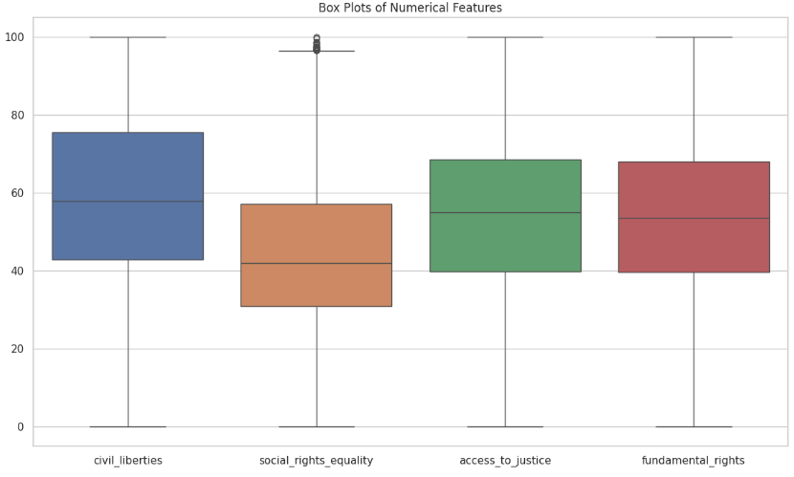
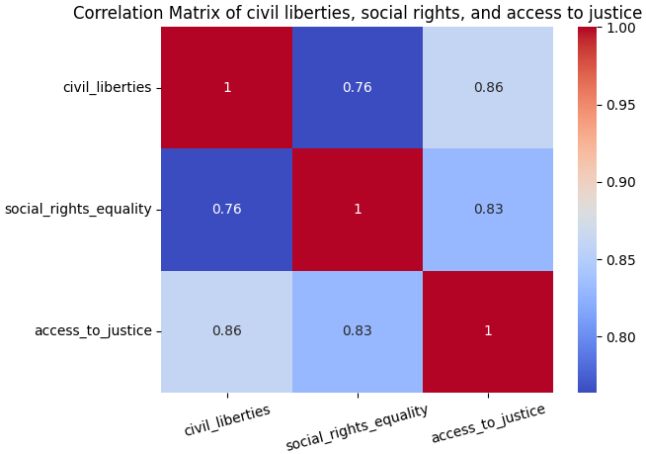
Exploratory Data Analysis
Box plot and Correlation Matrix
The median gives the idea that the central value of the social rights index is smaller than the other feature. This gap reflects and ongoing problem: while many countries ensure civil liberties and fair legal systems, equal access to welfare and social equality it’s more exclusive
The interquartile range (length of the box) shows the middle 50% of the data are in the range median +-15
All the correlations are strong and positive as we expected, but civil liberties have an higher correlation with access to justice than with social rights equality.
Many countries will have similar values of civil liberties and access to justice and a more detached social rights value.
Exploratory data analysis
17/12/2024
Slide <number>

Slide 9
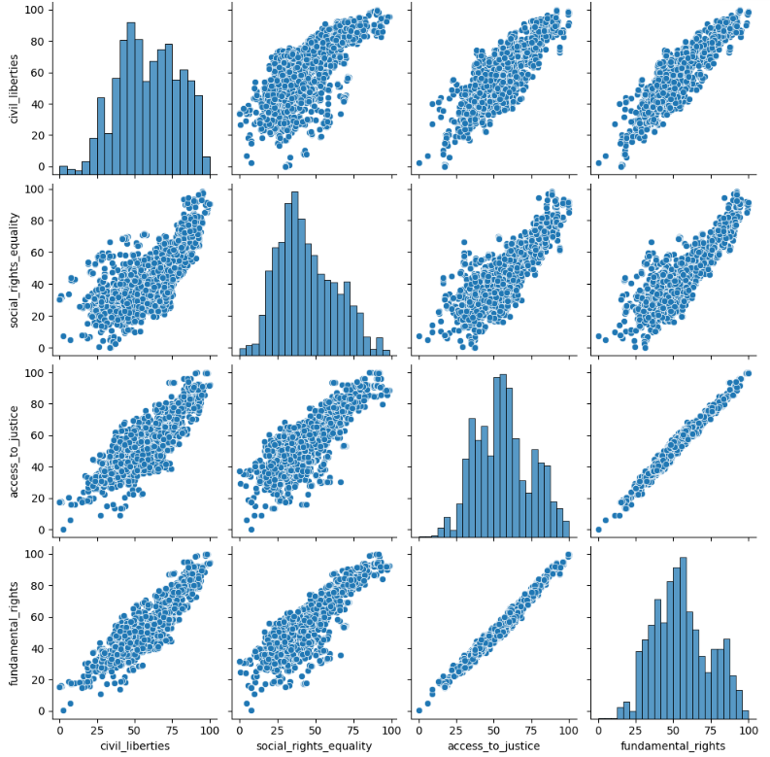
Exploratory Data Analysis
Bivariate data Analysis
We can see from this random sample of 2000 rows how there is a very high, positive correlation between access to justice and fundamental rights index that underscore their strong rdependence.
By contrast, the Social rights index appears more scattered.
Civil liberties index has medium-high values, while social rights index has medium-low values.
Exploratory data analysis
17/12/2024
Slide <number>

Slide 10
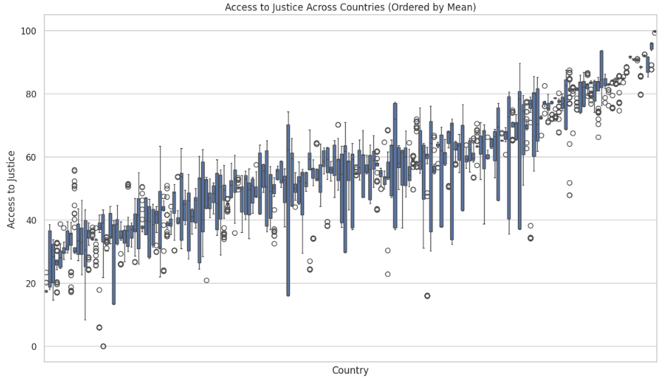
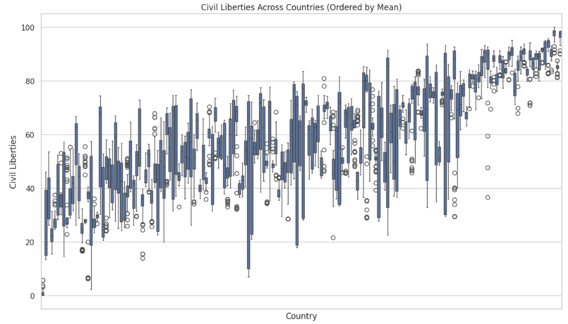
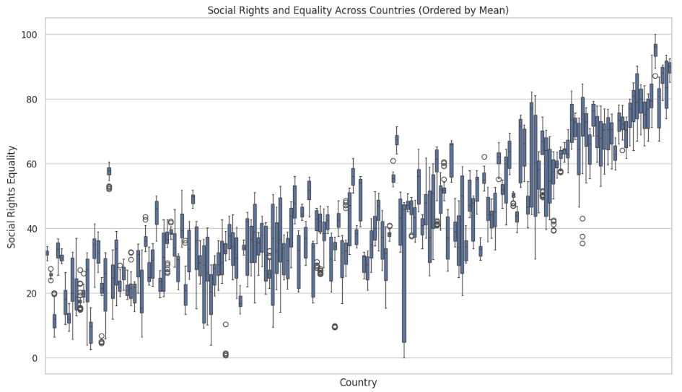
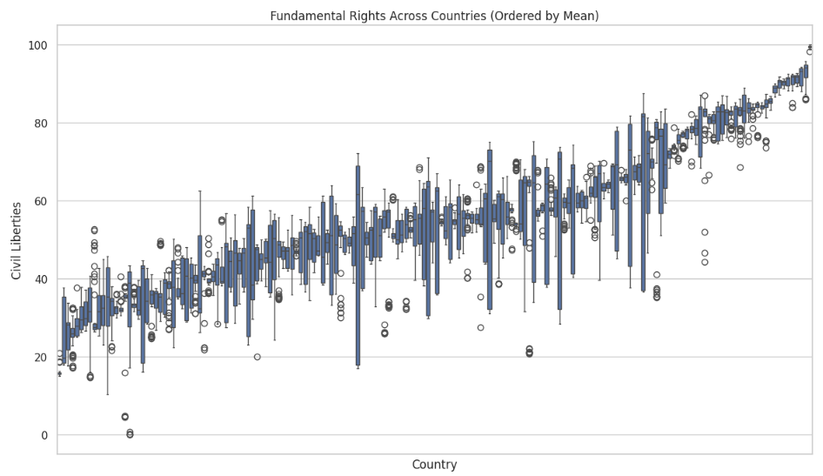
Comparative Data Analysis
Comparative analysis
17/12/2024
Slide <number>

Slide 11
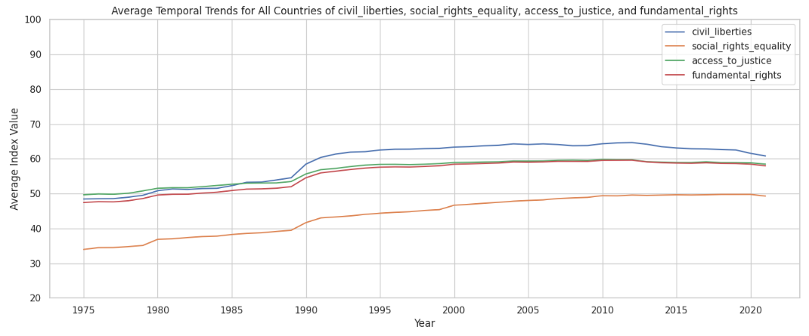
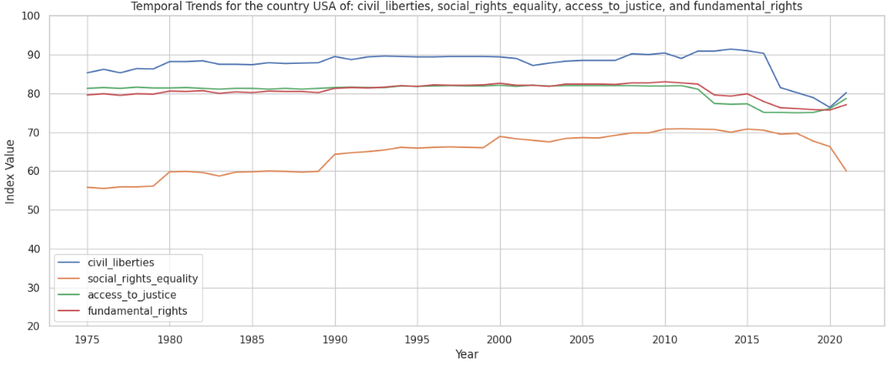
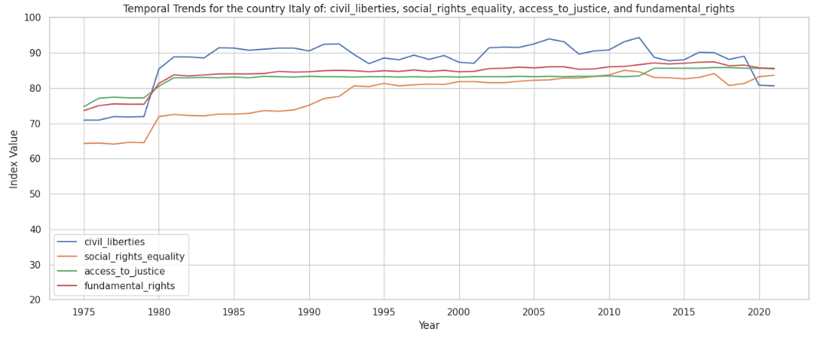
Trend Analysis
There is a visible general increase of all the index in the past 47 years, but a slight decrease can also be noted in the last 10 years.
In all the plots it’s easy to notice that social rights and equality index has smaller values than others.
Comparative analysis
17/12/2024
Slide <number>

Slide 12
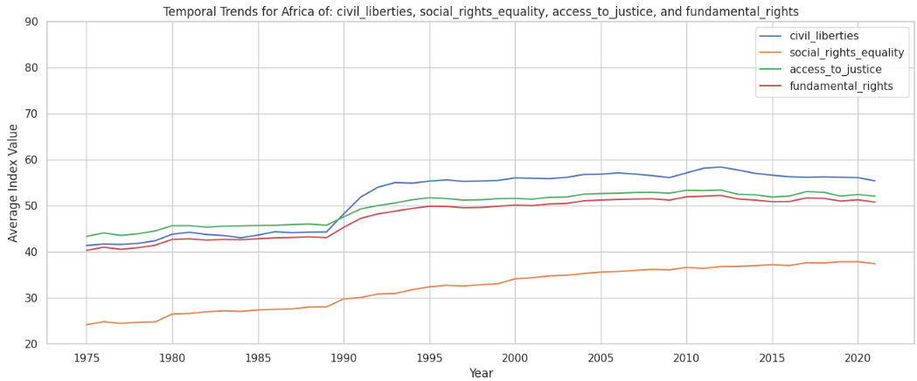
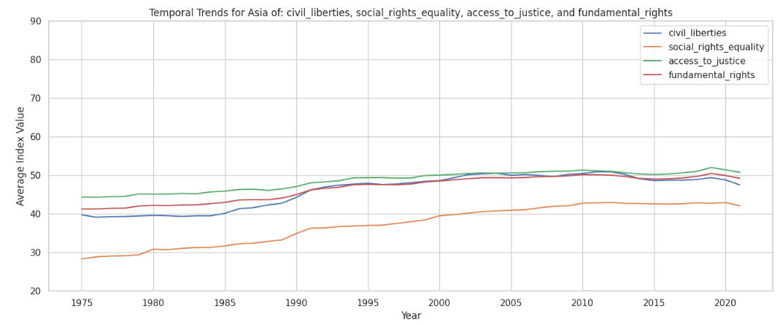
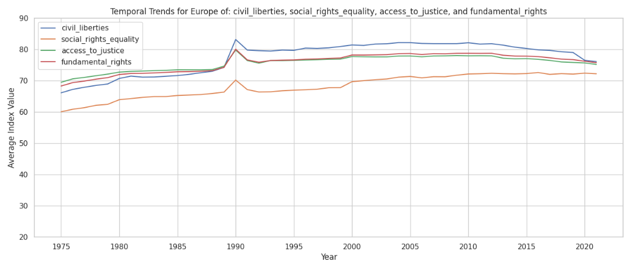
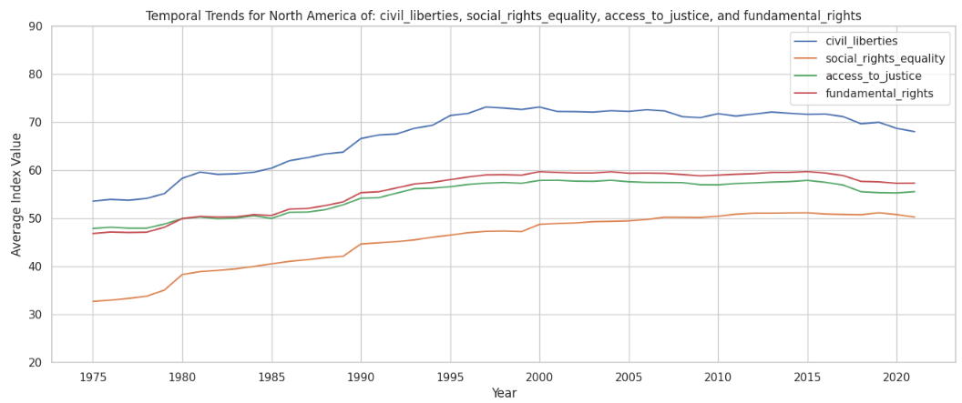
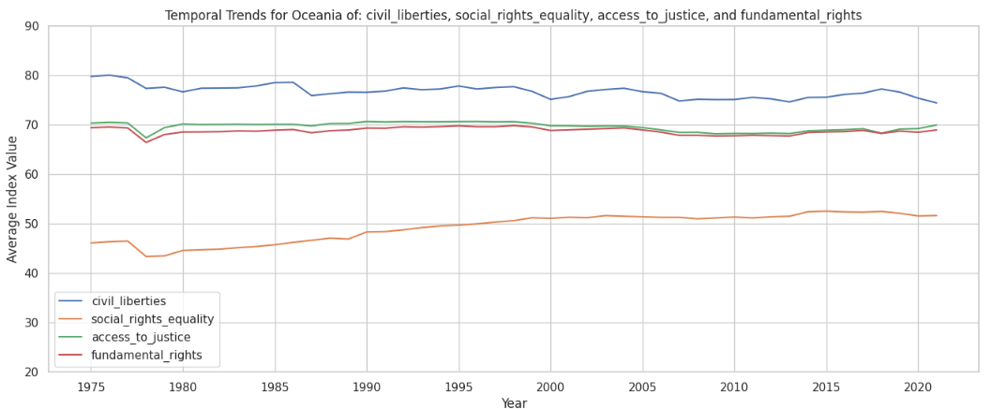
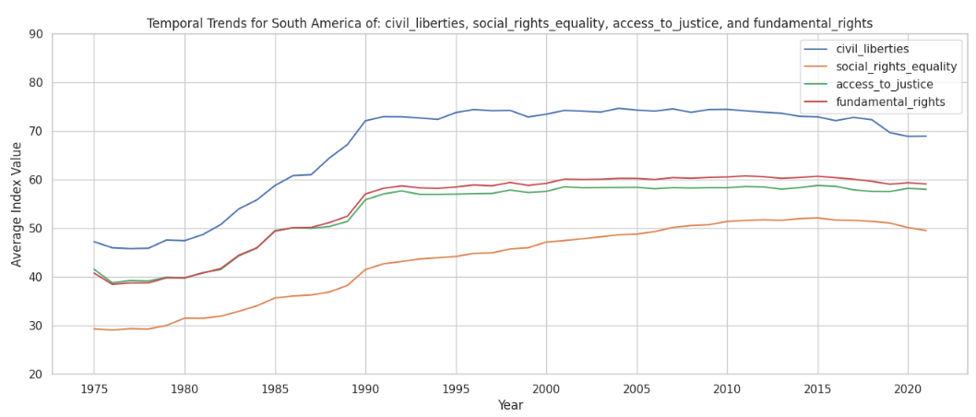
Trend Analysis Across Continents
Comparative analysis
17/12/2024
Slide <number>

Slide 13
Model Based Analysis
Linear Regression
Linear regression is used to predict values of the feature Fundamental Rights index using the other three indices.
Multiple Linear Regression
Multiple linear regression is used by combining the three sub-attributes to predict the four indices.
Support Vector Machines (SVM)
Comparison between three kernels to understand which model complexity gives the best result with the drawback of time consumption.
Decision Tree and Random Forest
Decision Tree (with hyperparameter tuning of max depth) and then Random Forest are used to predict values of Fundamental Rights index
Model Based Analysis
17/12/2024
Slide <number>

Slide 14
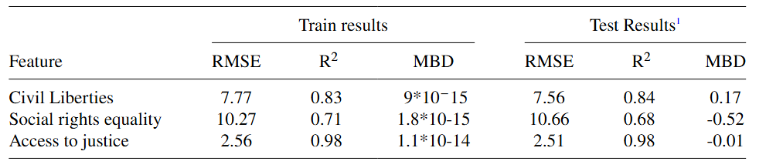
Linear Regression
We performed some linear regression to predict fundamental rights index using the other three feature as input of the model.
We take a very simple dataset with few features and not very complicated relations between them. So we expect linear regression to act good with this data.
Here there is a table to show the results of train and test for each input feature.
As we can clearly see, except for features that had strong, linear correlations, such as the Access to Justice Index, we have high RMSE values.
For indices with more complex relationships, such as Social rights and equality, linear regression struggled to provide accurate predictions. The results are bad so it’s better to try models more capable to understand relations that are not linear.
Model Based Analysis
17/12/2024
Slide <number>

Slide 15
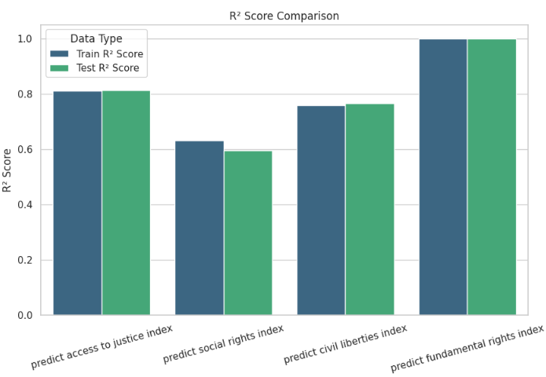
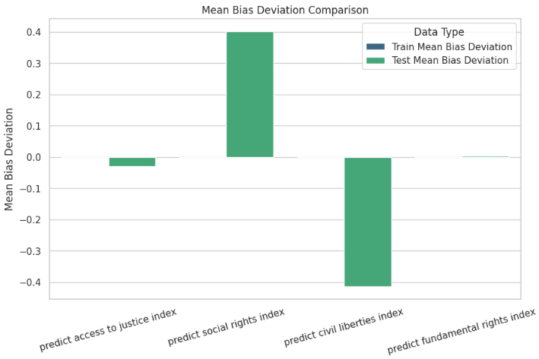
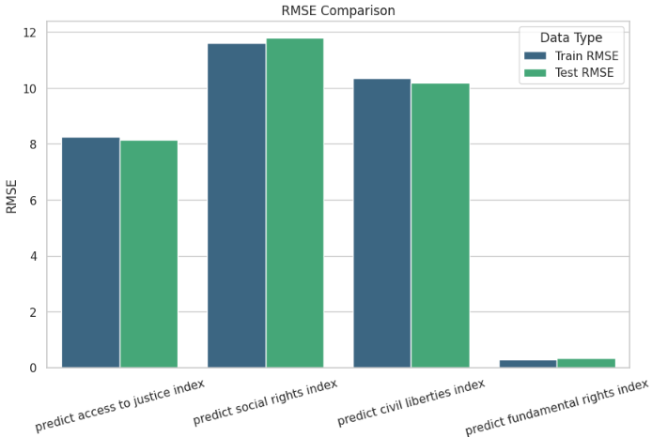
Multiple Linear Regression
The feature used are (ordered as they are plotted):
civil liberties index and social rights index to predict access to justice index
civil liberties index and access to justice index to predict social rights index
access to justice index and social rights index to predict civil liberties index
access to justice index, social rights index and civil liberties index to predict fundamental rights index
Model Based Analysis
17/12/2024
Slide <number>

Slide 16
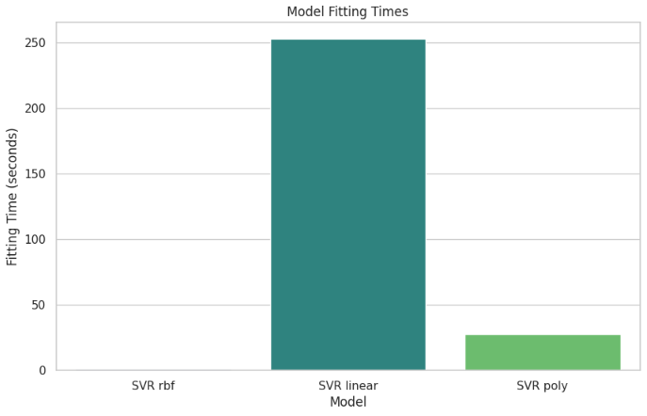
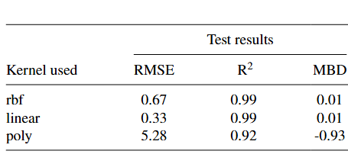
Support Vector Machines (SVM)
SVM use different kernel functions to handle non-linear relationships in the data. The three commonly used kernels are:
Linear Kernel: for linearly separable data.
RBF Kernel: Most used: handles non-linear relationships well.
Polynomial Kernel: Captures polynomial relationships
As we can see from the plot SVR is very fast, like Linear Regression, Multiple regression and Decision Tree with rbf kernel. It last about 30 seconds with polynomial kernel (with very poor results) and more than 4 minutes with linear kernel which has the best results.
Obviously linear dependency is the best one but it takes too much time to train so it’s a better choice the SVR with rbf kernel.
Model Based Analysis
17/12/2024
Slide <number>

Slide 17
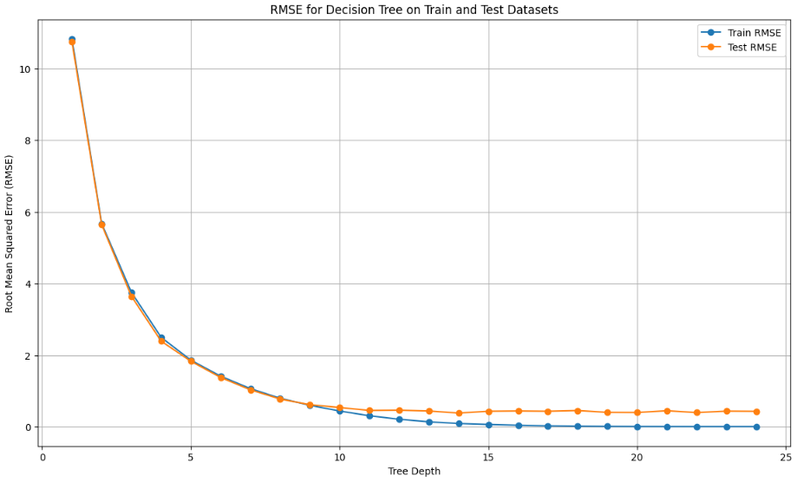
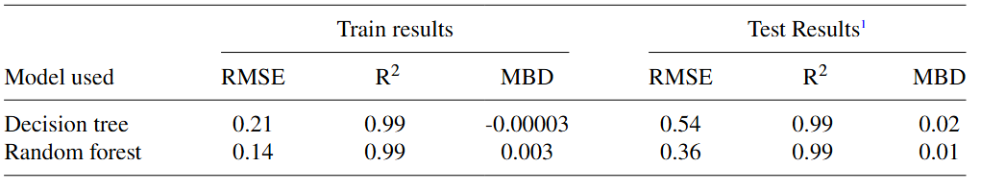
Decision Tree and Random Forest
On the right it’s represented the RMSE for Decision Tree on train and test dataset depending on the max depth. The best depth values are around 10-12 because, from that value on, RMSE of the test is stable and the model starts to overfit.
As we can see from the table both Decision Tree (with max depth fixed to 12) and Random Forest works very well. The results are up to 10 times better than Linear Regression, similar to Multiple Regression and to SVM but in a shorter time.
Model Based Analysis
17/12/2024
Slide <number>

Slide 18
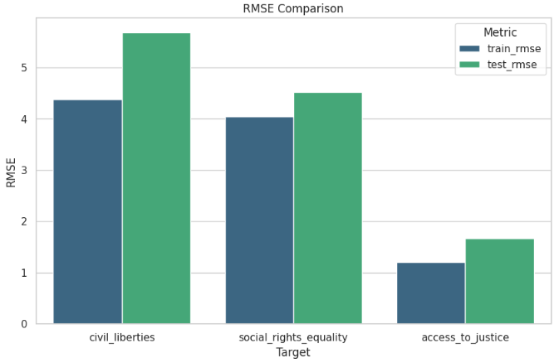
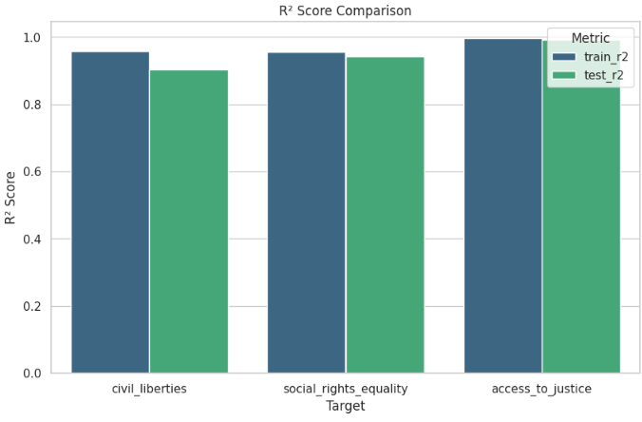
Time Series Predictions
Finally after trying different models and type of prediction we dig into time series predictions.
First, the values of the last 5 years of al the indices are removed from the dataset to predict them.
Among all models Multiple Linear Regression produces the best results, so it’s the only one shown in the tables.
As can be seen once again, access to justice is the easiest index to predict because its values have a linear behaviour whereas the other two indices have values with a high variance.
Time series analysis
17/12/2024
Slide <number>

Slide 19
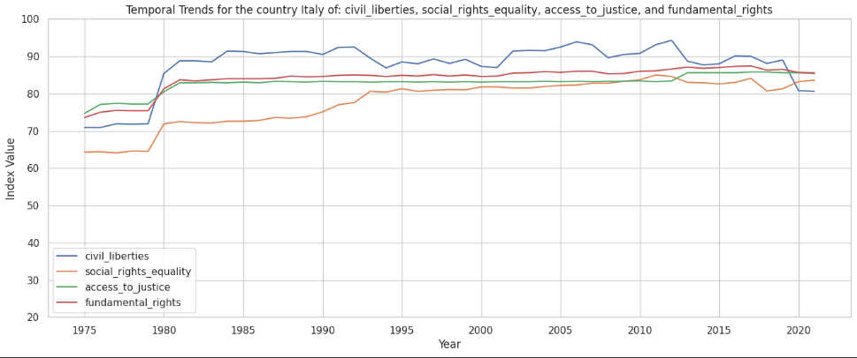
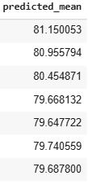
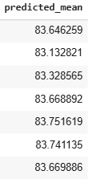
Time Series Predictions
As final tool, a specific model is used for time series predictions (ARIMA).
Access to justice and social rights and equality indices next 7 years
(not present in the dataset) of the country Italy are been predicted.
Civil liberties
Social rights equality
ARIMA model finds historical structures and patterns in data to predict future values. ARIMA predicts stable values for Social rights equality and slightly decreasing values for Civil liberties, continuing the trend visible in the plot.
Time series analysis
17/12/2024
Slide <number>

Slide 20
Conclusion and reflections
Correlation and Influence:
Access to Justice index has the highest correlation with fundamental rights index. Social rights and civil rights have positive correlation with the other indices but they have more outliers.
Comparative Analysis:
Civil rights mainly, but also access to justice, have higher values than social right and equality, symptom of a development of individual but not collective freedoms.
As expected Europe has the highest indices, Asia and Africa the lowest ones, North and south America have similar values. Remarkable is the difference in social rights and equality index between the USA and Italy.
Temporal Trends:
General increase of all the indices but with a slight decrease in the last years. Oceania is the only Continent stable in all the years. Breakpoints present in Africa, Europe and South America after important geopolitical events.
Predictions:
Some model like Decision Tree, Random Forest and Support Vector Machines worked very well.
We have good results in forecasting especially for the two more stable index: access to justice and fundamental rights.
Conclusion
17/12/2024
Slide <number>

Slide 21
Thank you for the attention!
Any questions?
Datasets
https://www.gapminder.org/data/
http://gapm.io/ddemocrix_idea
https://www.idea.int/democracytracker/gsod-indices
GitHub Code
https://github.com/Domenico00git/Big-Data-for-Official-Statistics
Conclusion
17/12/2024
Slide <number>

